Slide 1
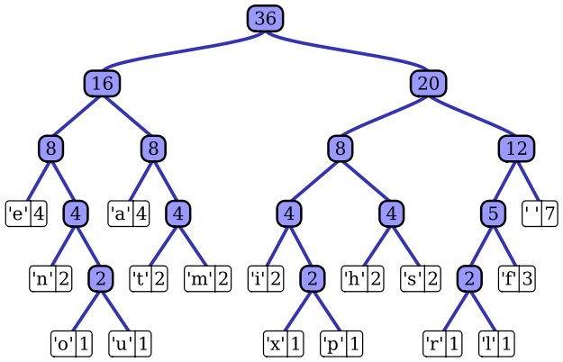
A Priority Queue to Implement Huffman Encoding
By :
Alexander Cannell
Nathan Erickson
Chris Kelly
Notes:
Introduce Everyone, what we are presenting

Slide 2
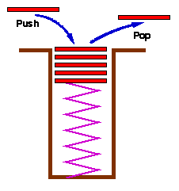
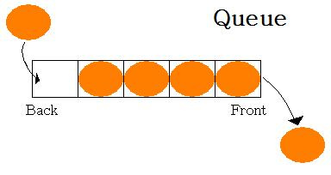
Queue
Like a Stack which is Last In - First Out where elements are pulled.
A Queues elements are pulled First In - First Out.
Notes:
Stacks are a type of container adaptor, specifically designed to operate in a LIFO context (last-in first-out), where elements are inserted and extracted only from one end of the container. queues are a type of container adaptor, specifically designed to operate in a FIFO context (first-in first-out), where elements are inserted into one end of the container and extracted from the other.

Slide 3
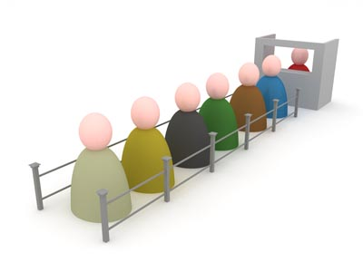
Priority Queue
A Priority Queue is an abstract data type which like a regular queue or stack data structure, but where additionally each element has a priority associated with it. The higher the priority always comes first in the queue.
Notes:
Priority queues are a type of container adaptors, specifically designed such that its first element is always the greatest of the elements it contains, according to some strict weak ordering criterion. This context is similar to a heap, where elements can be inserted at any moment, and only the max heap element can be retrieved (the one at the top in the priority queue). Priority queues are implemented as container adaptors, which are classes that use an encapsulated object of a specific container class as its underlying container, providing a specific set of member functions to access its elements. Elements are popped from the "back" of the specific container, which is known as the top of the priority queue.

Slide 4
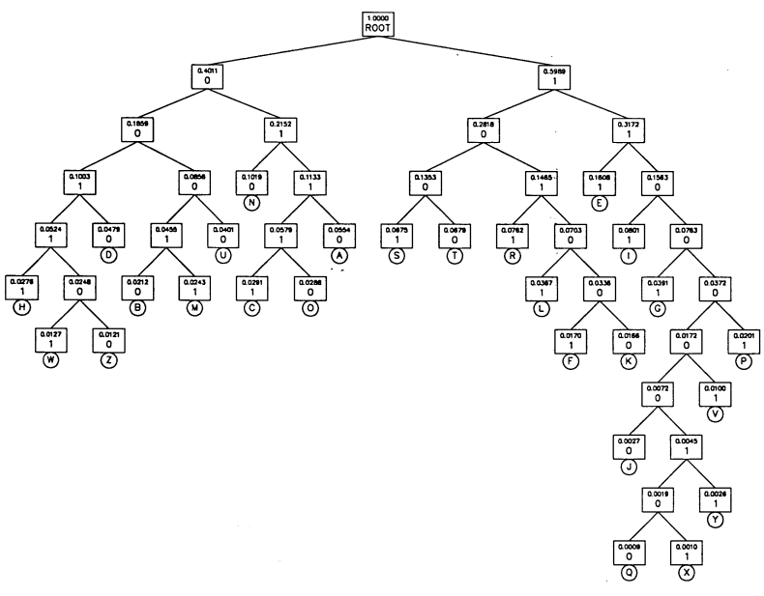
Huffman Coding
Huffman Coding is an entropy encoding algorithm used for lossless data compression. The term refers to the use of a variable length code table for encoding a source symbol where the variable length code table has been derived in a particular way based on the estimated probability of occurrence for each possible value of the source symbol. Developed by David A Huffman PHD in 1952. "A Method for the Construction of Minimum-Redundancy Codes".
Notes:
Developed by David A Huffman PHD in 1952. "A Method for the Construction of Minimum-Redundancy Codes".
A lossless data compression algorithm which uses a small number of bits to encode common characters. Huffman coding approximates the probability for each character as a power of 1/2 to avoid complications associated with using a nonintegral number of bits to encode characters using their actual probabilities.

Slide 5
Huffman Coding
Notes:
Do an Example on the board.

Slide 6
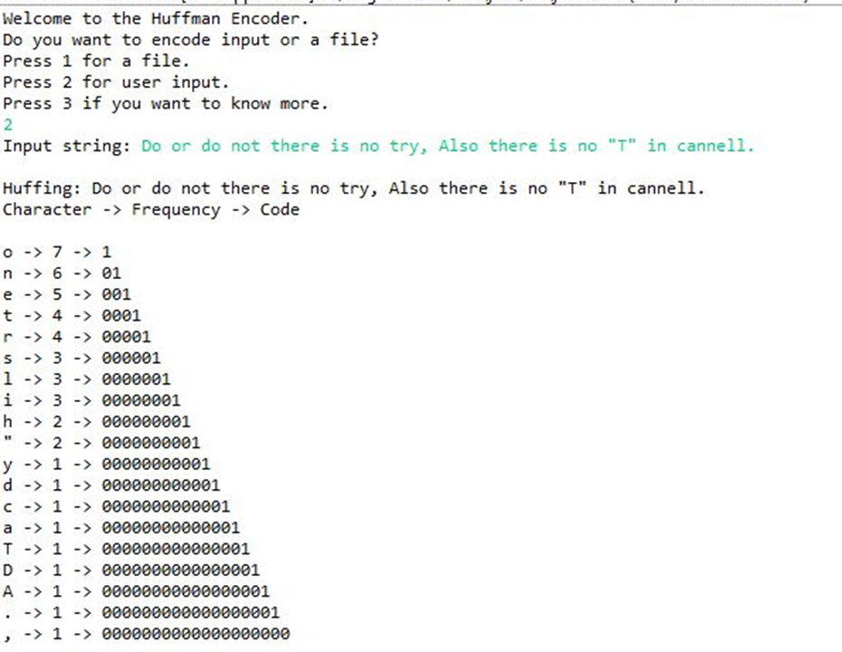
Over-Look
The Beginning
Takes Input
Splits Characters and Frequencies Using a TreeMap
Put it into the Priority Queue
Took values out of the Priority Queue Sorted by frequency (priority).
Printed the Values.
The End
Notes:
The Beginning
Takes Input
Splits Characters and Frequencies Using a TreeMap
Put it into the Priority Queue
Took values out of the Priority Queue Sorted by frequency (priority).
Printed the Values.

Slide 7
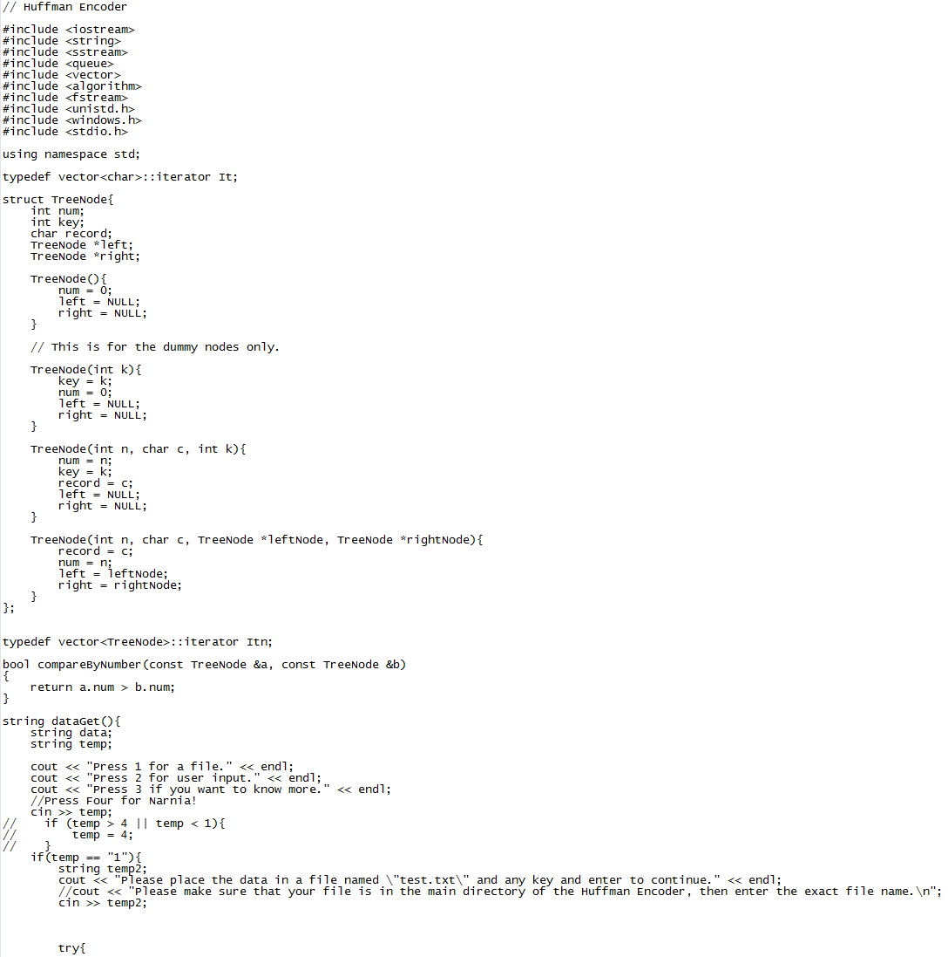
Methods/Classes
Classes:
-Huffman
Methods:
-DataGet
-Main
-TreeNode

Slide 8
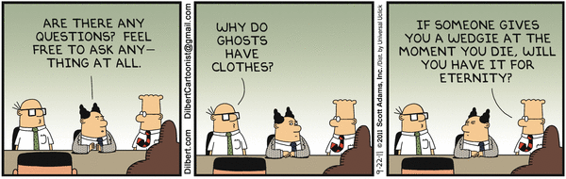
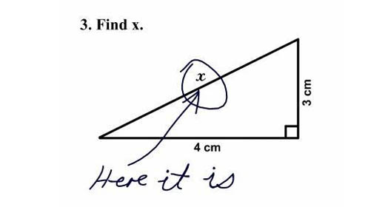
The End!
Any Questions?

